Slide 1
Negotiating the Social Borderlands:
Portraits of Young People with Disabilities and Their Struggle for Positive Relationships
Janet Sauer, Assistant Professor, Special Education
University of Colorado
Colorado Springs
Email: jsauer@uccs.edu
WEBSITE: http://www.uccs.edu/coe/people/faculty/sauerj.html
Notes:
I teach at UCCS and provide in-service workshops around the country. I previously taught PreK-HE in Boston, Africa, on the Navajo Reservation, in Appalachia, Iowa and Colorado.

Slide 2
Who is here?
How did you learn about this session, via AAIDD?
I hope you’ve had the opportunity to read the book.
Our audience includes people from various contexts, positions, roles, and geographic locations.

Slide 3
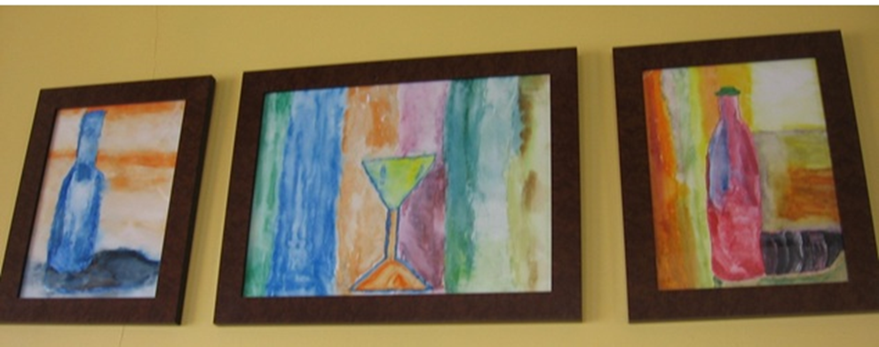
Portraits of David, Katie, & Marie
Sara Lawrence-Lightfoot (2005) developed portraiture as a form of qualitative research to record and interpret the perspectives and experiences of people she studied, documenting their voices and their visions - their authority, knowledge, and wisdom.
Notes:
I used portraiture research methodology for my yearlong study which is described in the book we are here today to discuss.

Slide 4
“One of the most powerful characteristics of portraiture is its ability to embrace contradictions, its ability to document the beautiful/ugly experiences that are so much a part of the texture of human development and social relationships…
The portraitist seeks to document and illuminate the complexity and detail of a unique experience or place, hoping that the audience will see themselves reflected in it, trusting that the readers will feel identified”
(Lawrence-Lightfoot, 2005, p.9-13).

Slide 5
Examples of Portraiture
The Good High School (Lawrence-Lightfoot, 1983)
Pre-school teachers (Ayers, 1989)
Interrogating classroom relationships and events: Using portraiture and critical race theory in education research (Chapman, 2007)
Co-constructions with students with LD
  (Connor, 2006)

Slide 6
My study
Portraiture research requires structure, analytic rigor and empirical description while making active decisions “in selecting the themes that will be used to tell the story” (Lawrence-Lightfoot, 2005, p.10).
I collected participant-researcher field notes, artifacts (IEPs, drawings, worksheets), transcribed interviews, etc. for nearly a year with three young people with developmental disabilities and their families.
Notes:
Nearly 1000pages of data; Contact log, constant-comparative, discourse analysis

Slide 7
A little context
All three participants lived within an hour drive of Hutton, an upper Midwestern town.
“A lot of people stay here, and many are afraid of stretching, so we have limited exposure to the rest of America. We’re sort of a micro-community of America.”
“We have labor roots and most of us are blue-collar workers with traditional values.” He added, with some hesitation, “We’re unaccepting of differences.”
My own background & assumptions
Notes:
Intro story of recording the dinner conversation; ADA ‘90 “disability is a natural part of the human condition”, so why is the general public so unfamiliar with and segregated from people with disabilities? “The question is not what you look at, but what you see.” HD Thoreau ~what you see reveals who you are?

Slide 8
Book’s Portrait structure
Meeting ______
Social contexts (schooling, home, community, therapies)
Ways of knowing
Themes

Slide 9
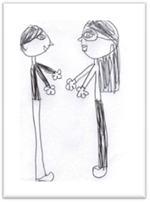
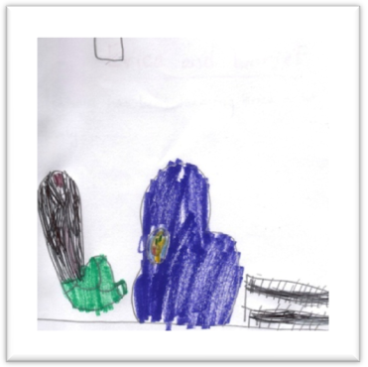
David, 10
Ways of Knowing David: “Burrr…eeee” or “EEE.” “Dad, Dad, Dad.”
“The words get stuck.” “He communicates with behavior.” Labeled autistic.
“David & I hugging.”
“We’re playing in his body sock.”
Notes:
His behaviors were not always viewed as meaningful. FBA. Bodysock

Slide 10
David
Examples of David’s agency, interest in books, music, and technology
David’s self-portrait?
David’s mother’s drawing of him.
Notes:
My observations of the teachers in David’s “integrated” classrooms indicated they did not address him directly nor ask him to contribute to class discussions. The adults in David’s special education classroom described students as “good” if they immediately complied with verbal directives or if they were quietly and independently working; students were described as “bad” if they got up from their desks or made vocalizations. Therefore, David was generally discouraged from talking in his typical school day.

Slide 11
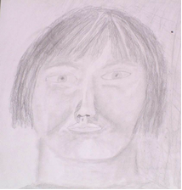
Katie, 17
Ways of knowing Katie: “It’s just hard to tell.” Diagnosed with trisomy 21
“Singing is what I do. I’m a pop diva.” “This is real, this is me.
I’m exactly where
I’m supposed to be.
Gonna let the light shine on me.”
Katie’s self-portrait
Notes:
Art, music, theater, letter writing Add Lolly ,English teacher?

Slide 12
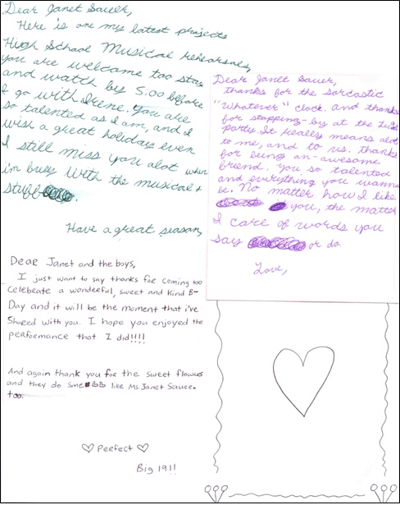
Katie
Examples of Katie’s literacy,
Agency, and intelligence
“This study is about me!”
“My house, my rules.”
Notes:
Katie also wrote affectionate letters to a classmate and an adult intervened - later.

Slide 13
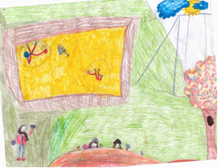
Marie, 8
Ways of knowing Marie: “Marie loves to be part of the action.” “She’ll be a great hall monitor.” Diagnosed with Rett syndrome “on the spectrum”
Marie & friend Brenda playing at the park.

Slide 14
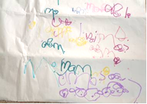
Marie
Examples of Marie’s agency, singing, emerging literacy & storytelling
“Look at me!”
“I watch you. You do it.”
“Guys careful.”
“I do it, self.”
Notes:
Reading books excerpt, singing spelling

Slide 15
Themes
Social borderlands
Imagination & Literacy
Agency

Slide 16

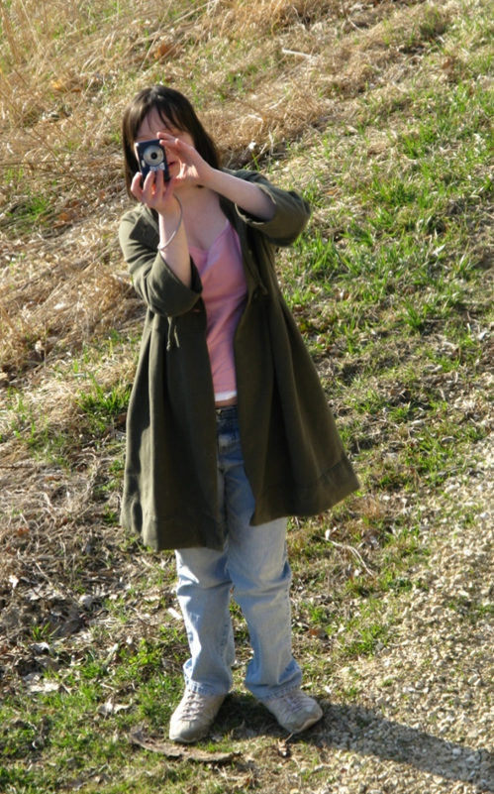

Negotiating social borders
Katie was in Life Skills & rode
a ‘short bus”
Katie sought out Theater, Speech, Photography, Art, & took US History
Notes:
“I am still looking for a McDonald’s ad for help needed. Then I’ll circle it like we did in Vocational Skills Class. We would read through the Classified Ads and circle jobs we could do, like places we could wipe tables and sweep floors.)

Slide 17
Negotiating social borderlands
Adults restricted peer interaction: “There were times we had real battles going down [to the special education room] because she kept wanting to be with the kids [in her class].”
Local understanding, or valued membership in inclusive social contexts was a positive contributing factor to social, academic, and literacy development. “You’re not trying to work with a syndrome; you’re trying to work with a little girl.”
Notes:
“relationships matter’ Wagner, Cadwallader, Garza, & Cameto (2004) in Erik Carter, TASH “peer-mediated supports”; Kliewer’s local understanding

Slide 18
The power of imagination
Opportunities to create stories, whether in a young child’s play area, or in older students’ conversations, are important to developing literacy.
Imagination played a role in David, Katie, and Marie’s emerging literacy. The findings affirm that people labeled with significant disabilities are imaginative. Implications suggest educators, support personnel, and families should pay attention to the imaginative capabilities of young people considered to have significant disabilities and capitalize on these skills and interests as part of supporting students’ literacy development.
Yet, there was adult/structural resistance to supporting their literacy: “I sometimes have trouble with Marie’s writing.” Where are the opportunities in a child’s life? Is it reflected in the IEP? What supports are necessary?
Notes:
(Cazden, 2001; Paley, 2004; Zigler, Singer, & Bishop-Josef, 2004). See In Youth: Responding to lives - An international handbook, A. Azzopardi, Editor. Boston: Sense Publishers.

Slide 19
“Look at me!”: Portraiture and Agency
Historically, the dominant research paradigms involving the study of people with disabilities involved experimentally designed studies or other medically orientated approaches. The “subjects” asserted themselves in ways akin to Giroux’s agency (1992) suggesting portraiture might provide a unique and credible avenue to respectfully study and learn more about people with disabilities too often left on the fringe of society and research.
Notes:
See also Disability Studies Quarterly ‘12; Lois Heshusius & Lovett’s “listening”

Slide 20
Lessons Learned & Questions
Child and family voices need to be valued
Increase Self-awareness & reflection: “And it only took me like 3 to 4 weeks to figure out that she needed to be in the [general education] room… she’s telling me this. Why didn’t I pick up on it?”
How might families and educators become more self-aware?
What does agency look like in the lives of the young people with whom we work and live?
Where are the opportunities for these young people to develop reciprocal relationships? (are they in IEPs?)
Where are the opportunities for these young people to develop literacy and use their imagination? (are these evident in IEPs?)
Notes:
Cazden (2001) writes, “The most important asymmetry in the rights and obligations of teachers and students is over control of the right to speak” (p.82). Cazden’s idea of speaking rights is a useful idea for discussing David’s communication. It suggests that David should have had the right to speak, or in his case, use whatever means he might have to communicate, to share his thoughts and feelings with others. The other part of speaking rights, Cazden asserts, is listening responsibilities, where teachers (and others) listen and respond to students’ voices.

Slide 21
Professional Preparation
Teachers, Therapists, and other support personnel are like researchers in that they meticulously document everything.
University students begin with self-examination, parallel the IEP process, spend time with families or professionals, share their portraits.
University students research the experiences and perspectives of an educational team member through observations, interviews, and related readings, and use this information to develop a narrative Portrait and (co)present to class.
Notes:
*might be FAF, Parent organizations where we ‘lean forward and listen to families’ (Harry) cross-disciplinary collaboration (at the PDS, Clarke)

Slide 22

Who am I?
Vision
Concerns
Strengths
Support
Needs
Interests
Notes:
To do: Create Self-portraits & Portraits of students based on context/family, observations, artifacts, active listening – see Ed.Week article moving from deficit model to strength-based education for neurodiverse students

Slide 23
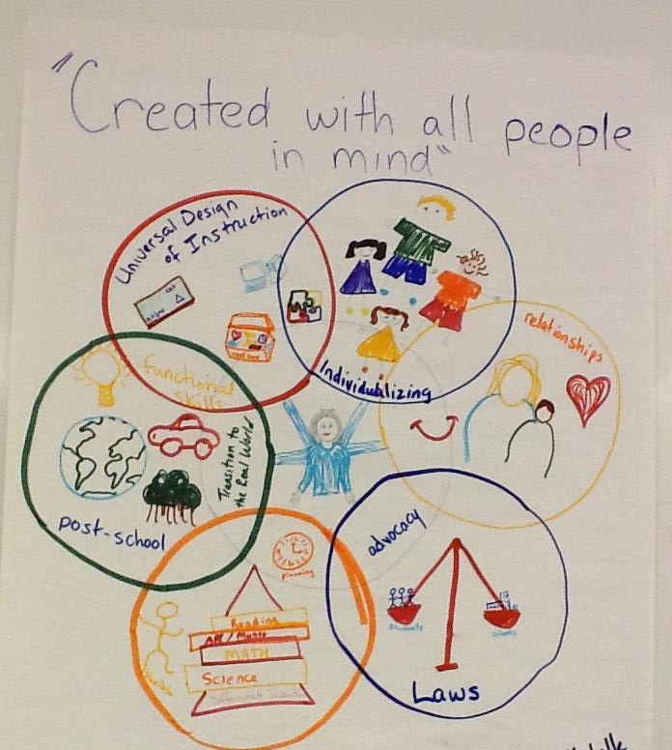
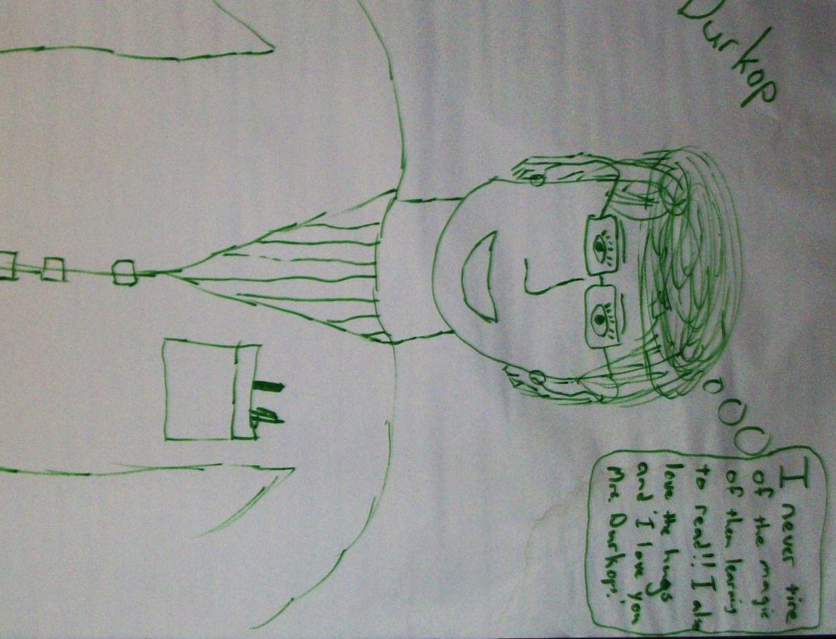
Portraits of teachers in the field: A disability studies perspective
Notes:
(DSE, 2009?) general, specialist, and special education teachers 1) struggle with meeting the range of student needs, 2) acknowledge the importance of collaboration but admit “it’s hard,” and 3) play a part in the social construction of (dis)ability. Ability privilege.

Slide 24
Disability Portraiture in
Pre-service Teacher Education
Introduction to Special Education students were introduced to the history of the field, including federal laws, and portraiture research.
Through autobiographies, text and article readings, students studied the value of learning from families.
They were provided with modeling and an interview guide:
  Tell me about yourself (or your child) and your (or his/her) interests.
  Can you describe what has gone well in school?
  Can you tell me about any struggles you have had?
  What do you wish everyone would know about your child and your family?
Assigned to integrate the interview with readings in a portrait narrative.
Notes:
Based on Seymour Sarason’s studies of family-school relationships.

Slide 25
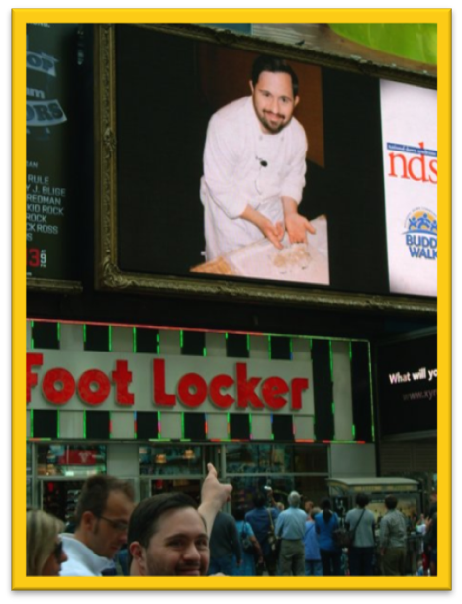
Disability Portraiture in
Pre-service Teacher Education
Coleman Institute conference: “Aim high”: A Family’s Story of Success
  Colorado, October 13, 2011, With Jenny Romano, Graduate Student
“Michael saw himself as belonging, as one of the guys. He never saw himself as disabled.”
“Never let numbers determine your child’s school program.”
“I wanted him to be a part of the nondisabled world because that is the world we live in.”
“Aim High.”
“I Love My Life, Because, God Don’t Make Junk!”
Notes:
Issues in Teacher Ed (in press): families know a lot; they’re normal

Slide 26
Next steps?
Increase recruitment of minority families in professional preparation programs: pre-service teacher, counseling, social work, criminal justice
Portraiture study of culturally and linguistically diverse families
Notes:
To get at complexities/subtleties, overrep., privilege

Slide 27
Thank you
Special thanks to the families, the schools, and administrators who provided me with access and permission to observe, collect data, interview, etc.
I appreciate AAIDD’s recognition of the value of case study research by publishing this book and the editorial assistance from Lisa O’Hearn, and Danielle Webber for organizing this “book chat.”
Notes:
Refer to prospectus’ audience/purpose & Brantlinger manuscript

Slide 28
Q & A
What is your take-away?
How might you become more aware of your patterns of social interaction (conversation habits)?
What more would you like to know?
Negotiating the social borderlands: Portraits of young people with disabilities and their struggles for positive relationships (AAIDD).
Click here to purchase your own copy of the book.

